Slide 1
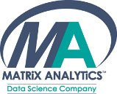
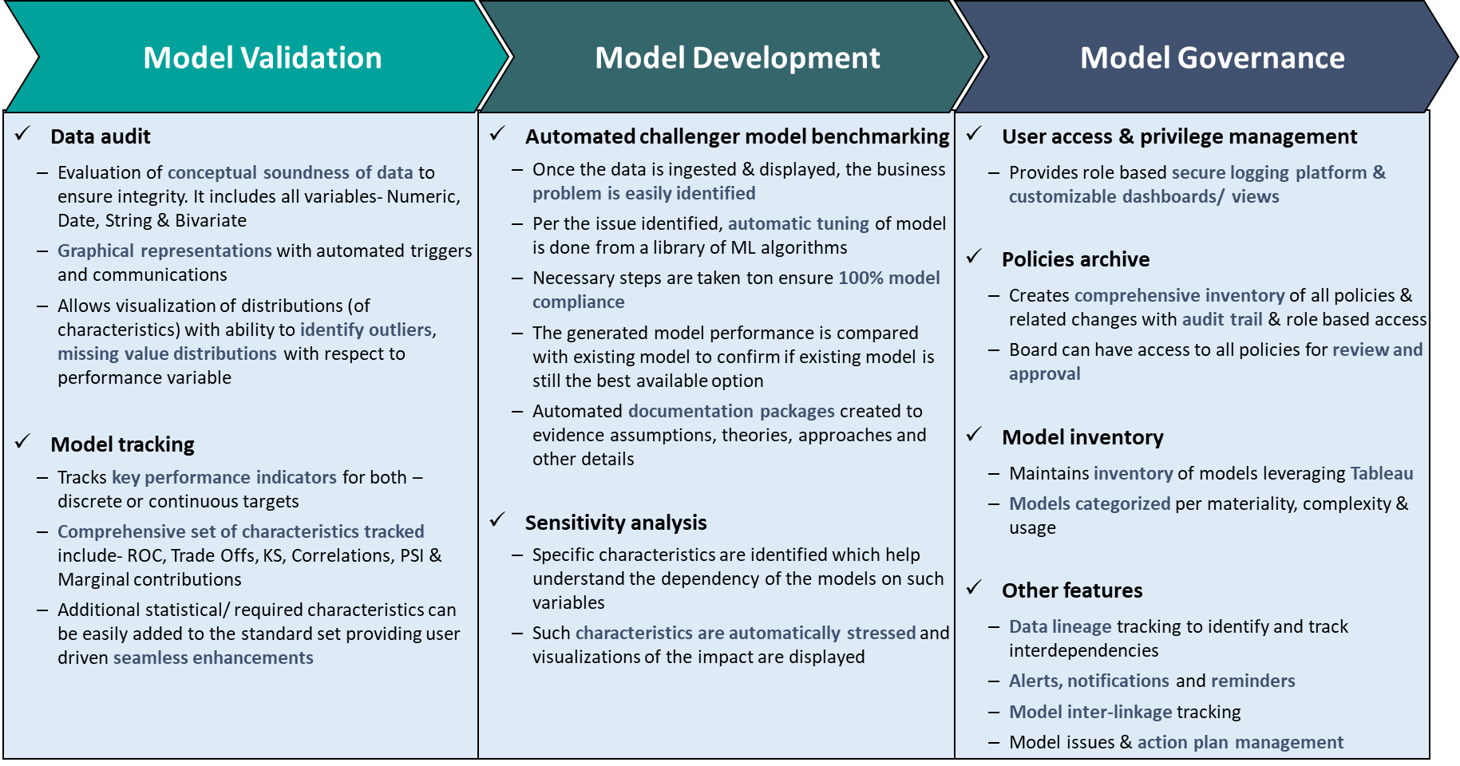
MATRiX ANALYTiCS CORPORATION
MA-MODEL RISK MANAGEMENT (MRM)
End to end automated Model Risk Management solution providing 100% compliance to SR 11-7 guidance from FRB and OCC.
MA-MRM solution includes set of tools/ functionalities for effective model risk management & oversight
Modular design providing flexibility to match client needs, maximizing the ‘bang for the buck’
Covers all 3 essential components including model development, validation & governance
Why MA-MRM?
Compatible with most data inputs e.g. EAP, Hadoop etc.
Automated data analysis/ review and data quality checks
Model performance monitoring including all standard statistical concepts. Additional measure easily added
Tableau interface which is highly customizable
Automated challenger model development
Auto generated model documentation per Citi MRM
Flexible & customizable work flows
MA-MRM solution- Design & Overview
Contact Information | +1.201.710.7810 | info@matrixanalyticscorp.com | www.matrixanalyticscorp.com Transforming Data into Expert Decisions

